Slide 1
Employee Data Analysis using Excel
STUDENT NAME: YUVASHNI B
REGISTER NO: 312214683
NAAN MUDHALVAN ID: asunm1475312214683
DEPARTMENT: PG AND RESEARCH DEPARTMENT OF COMMERCE.
COLLEGE: SRI KANYAKA PARAMESWARI ARTS AND SCIENCE COLLEGE FOR WOMEN , CHENNAI-600001.

Slide 2
PROJECT TITLE
Employee Performance Analysis using Excel

Slide 3


AGENDA
Problem Statement
Project Overview
End Users
Our Solution and Proposition
Dataset Description
Modelling Approach
Results and Discussion
Conclusion
3/21/2024 Annual Review

Slide 4
PROBLEM STATEMENT
An employee performance analysis problem statement can be written to identify a gap in evaluating employee performance and its potential impacts. For example, a problem statement might say, "It is difficult to evaluate employee performance, which may result in increased errors, higher turnover, or reduce our ability to manage improvements".

Slide 5

PROJECT OVERVIEW
.
Employee performance analysis is a process that measures how employees perform on projects and assignments, and provides feedback to employees on their progress towards organizational goals. It also involves checking if performance standards and elements are realistic.

Slide 6


WHO ARE THE END USERS?
Employee
Managers
Executives
4. Training and Development Teams
Compensation and Benefits Teams.
Performance Review Committees
Employer.
Human resources team.

Slide 7

OUR SOLUTION AND ITS VALUE PROPOSITION
Solution Data-driven analysis that support performance reviews, promotions, compensation decisions, and targeted training
Solutions The ability to analyze both current and historical performance data, with periodic updates to keep information.
Value Proposition Saves time and reduces the risk of human error, ensuring consistent and reliable reporting across the organization.
Value Proposition Ensures the tool evolves with the organization's needs, staying relevant and effective in a dynamic work environment.

Slide 8
Dataset Description
EMPLOYEE ID: Unique identifier for each employee in the organization.
FIRST NAME: The first name of the employee.
PAY ZONE: The pay zone or salary band to which the employee's compensation falls.
DEPARTMENT TYPE: The broader category or type of department the employee's work is associated with.
CURRENT EMPLOYEE RATING: The current rating or evaluation of the employee's overall performance.

Slide 9

THE "WOW" IN OUR SOLUTION
•Performance level=IFS(Z8>=5,"VERY HIGH",Z8>=4,"HIGH",Z8>=3,"MED", TRUE, "LOW")
3/21/2024 Annual Review
9

Slide 10
MODELLING
DATA SET:
1.Kaggle
2.Employee dataset
FEATURE SELECTION:
1.Slicer.
2.Conditional Formatting.
3.Designing
DATA CLEANING:
Missing values.
Irrelevant data.
Correct Errors.
Remove Unnecessary Columns and Rows
PIVOT TABLE:
Employee ID
First Name.
3. Performance Score
CHART:
Report of Employee Performance based on their Current Ratings is resented as Column Chart
10

Slide 11
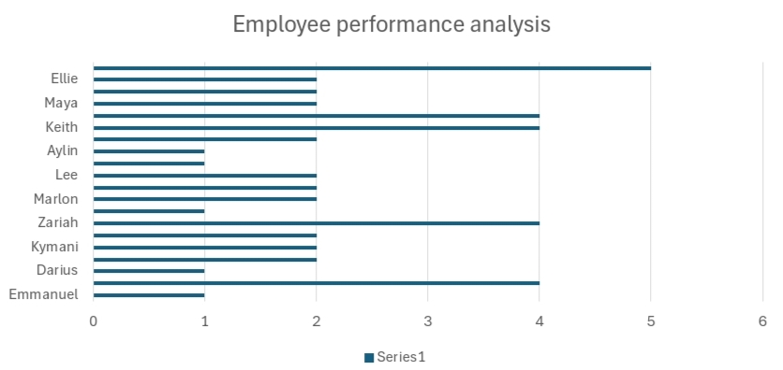
RESULTS
11

Slide 12
conclusion
In conclusion, conducting an employee performance analysis using Excel provides a structured and efficient way to evaluate and track performance metrics. Excels versatile junctions and teals, such as pivot tables, charts, and conditional Formatting, allow for clear data visualization and analysis, facilitating interned decision making.

Slide 13
THANK YOU!

